Slide 1
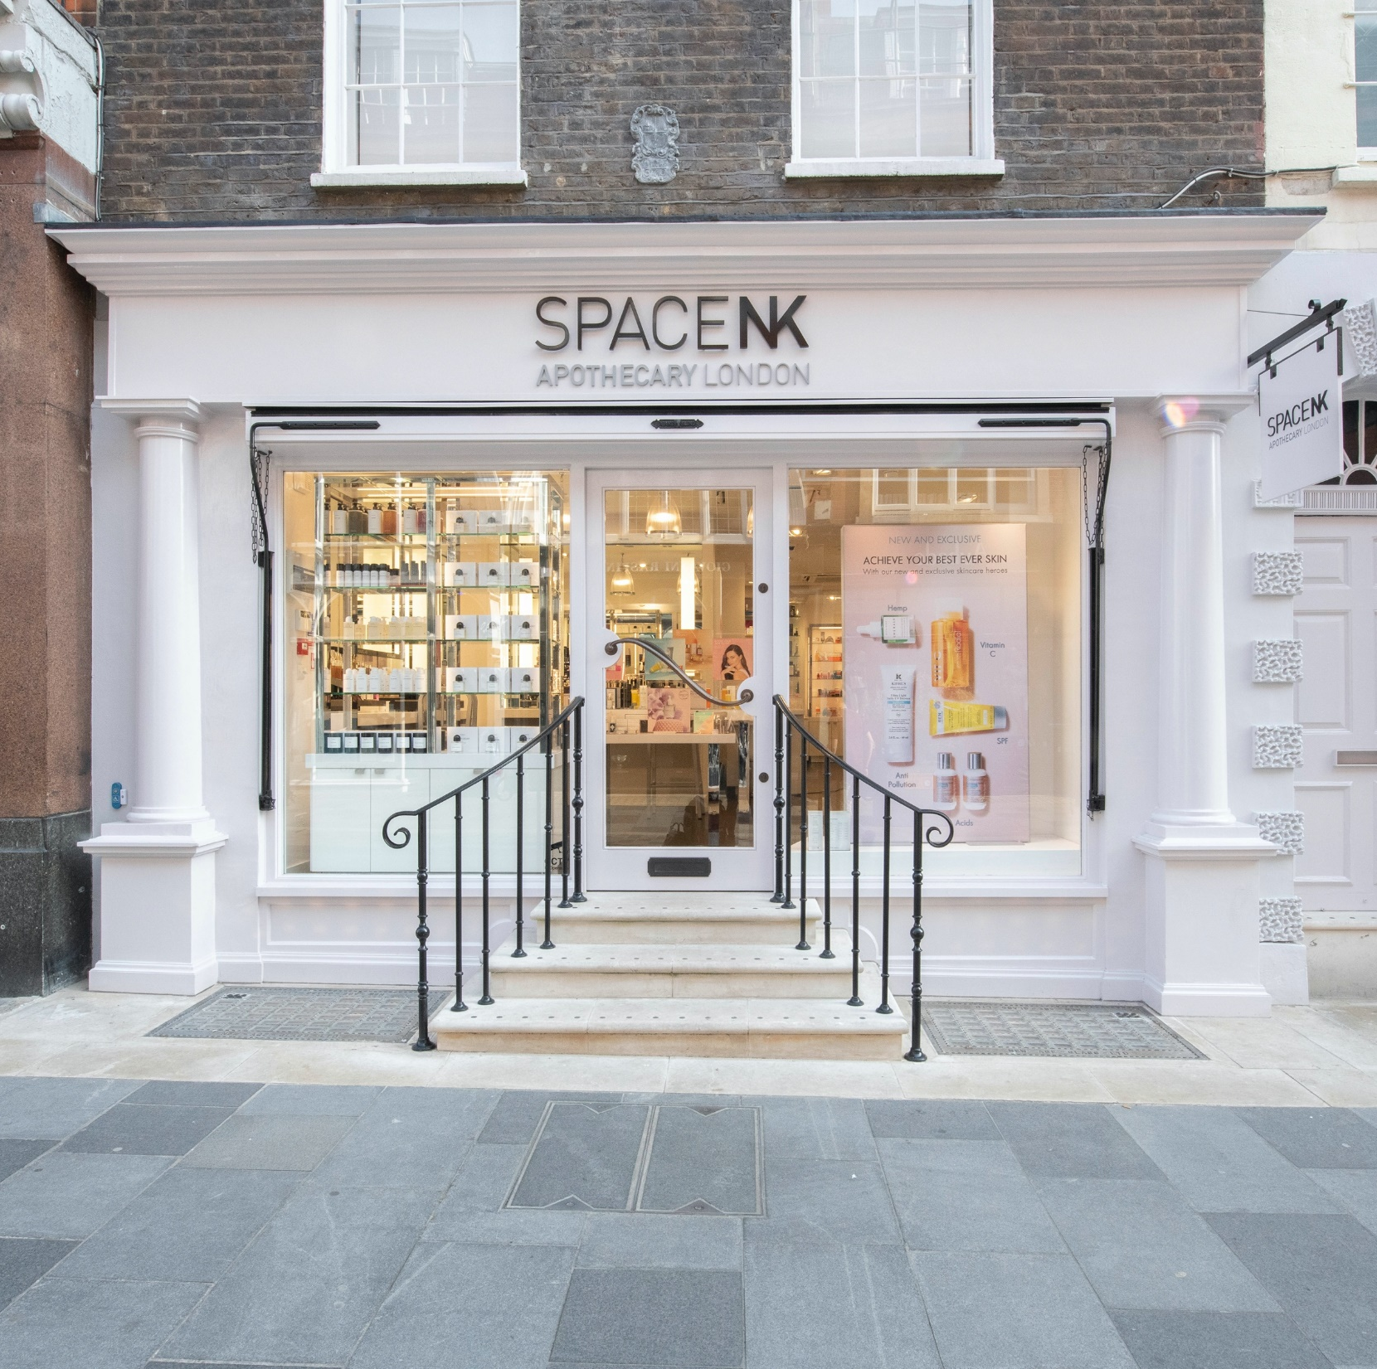
GENDER PAY GAP
2022 – for 2023 submission

Slide 2
The facts as of April 2022
To Give You Some Context……..
TOTAL
810 employees
94 males
716 females
Within our Support Office and Distribution Centre
228 employees
65 males
163 females
Within our Retail Stores
582 employees ( 405 are part-time)
29 males ( 19 are part-time)
553 females ( 386 are part-time)
In summary:
We have more female employees within our stores
We have more female employees within our Support Office functions
The number of men in the business has increased in both our retail and Support Office functions
Our business is relatively small.
There are very few teams in our Support Office functions where individuals have the same job titles and perform the exact same role.
Where employees are performing the same job role they are paid equally and fairly, however, we do take into consideration experience and current skill level.
We are committed to paying all our employees fairly no matter their gender, nationality, religion, race, background, or age, and we believe that we do so.
 | 2018 | 2019 | 2020 | 2021 | 2022
Total Employees | 725 | 755 | 762 | 764 | 810
Males | 73 | 72 | 72 | 70 | 94
Females | 652 | 673 | 673 | 694 | 716
Support/DC | 161 | 170 | 179 | 198 | 228
Males | 58 | 55 | 53 | 49 | 65
Females | 103 | 115 | 126 | 149 | 163
Retail | 563 | 575 | 585 | 563 | 582
Males | 14 | 17 | 18 | 19 | 29
Females | 549 | 558 | 565 | 544 | 553

Slide 3
Headcount – 2021 vs 2022
In summary:
We have more total employees vs 2021 – increasing our total headcount by 6%
We have recruited more males (26) than females (23) in the past year
We have recruited more males in to Support Office/DC roles within the past year
We have recruited slightly more men into the retail population in the past year
Our recruitment between the genders of males and females is quite balanced between the locations
 | 2021 | 2022 | Variance | % difference
Total Employees | 764 | 810 | +46 | + 6
Males | 70 | 94 | +24 | +34%
Females | 694 | 716 | +22 | +3%
Support/DC | 198 | 228 | +30 | +15%
Males | 49 | 65 | +16 | +32%
Females | 149 | 163 | +14 | +9%
Retail | 563 | 582 | +19 | +3%
Males | 19 | 29 | +10 | +53%
Females | 544 | 553 | +9 | +2%

Slide 4
Pay & Bonus Gap’s

Slide 5
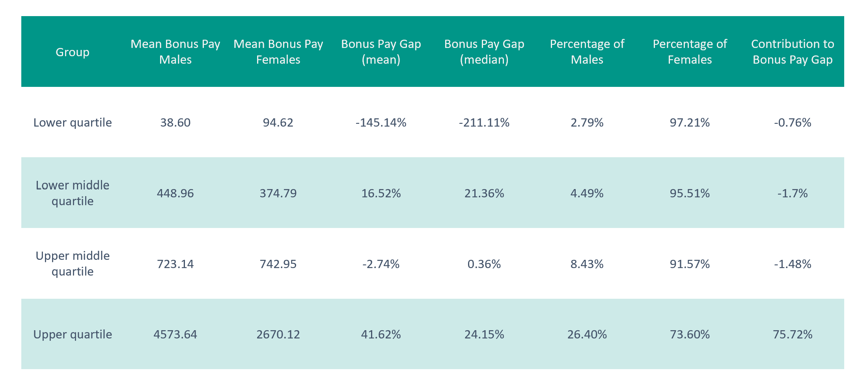
Gender Pay Gap – Quartile Distribution

Slide 6
Gender Pay Gap Y.O.Y
 | 2017(%) | 2018(%) | 2019(%) | 2020(%) | 2021(%) | 2022(%)
Gender pay gap mean pay rate (%) | 53.4 | 47.9 | 48.0 | 53.3 | 48.5 | 41.90
Gender pay gap median pay rate (%) | 42.2 | 16.9 | 24.2 | 38.1 | 29.3 | 25.65
Gender pay gap mean bonus (%) | 50.0 | 86.3 | 85.2 | 55.1 | 12.5 | 71.8
Gender pay gap median bonus (%) | -4.1 | 75.8 | 70.7 | 71.1 | 0.0 | 59.48

Slide 7
What We Are Proud Of… 2022
We recruited evenly across all genders, hiring for talent (please note that for the purpose of the Gender Pay Gap, the Genders have been defined as Male and Female, however at Space NK we recruit across all gender identities)
We have recruited more males into the business than females – as one of our aims was to try and attract more men to work with us – this has increased by 53% within retail
The number of females in the higher salary quartile has increased
We have introduced new bonus schemes to two of our three populations
We have issued in the year (2022) – 2 pay increases to ALL employees to take in to consideration the Cost of Living Crisis

Slide 8
Factors That Have Impacted Our 2022 Reporting
At the snapshot date for our 2021 reporting (which we have used for our 2022 comparison), all retail employees were furloughed under the UK government’s furlough scheme and this has skewed the data (e.g. the furlough scheme, more of the retail population was furloughed whilst the head office population continued to work throughout the pandemic, our stores were closed on and off in lockdowns)
The way in which the furlough scheme was calculated, resulted in many retail employees being paid above their usual hourly rate. This has had a positive impact on our Gender Pay Gap calculation.
We are not comparing like for like data.
Different stores will earn bonuses and the way in which it is calculated is not comparable.
New bonus schemes have been launched in 2022 for both the retail and Support office teams – therefore comparison data is not like for like.
Our headcount has increased

Slide 9
Challenges We Now Face
Our comparisons for this year have been impacted by the furlough scheme of the previous year and therefore it’s not a true and accurate reflection.
The beauty industry is still heavily female-dominated. We continue to work to break down this stigma and encourage men to apply for roles within our stores.

